Slide 1
PERFORMANCE CHARACTERISTICS OF INTERNAL COMBUSTION ENGINE
Department of Mechanical Engineering
Pulchowk Campus, IOE

Slide 2
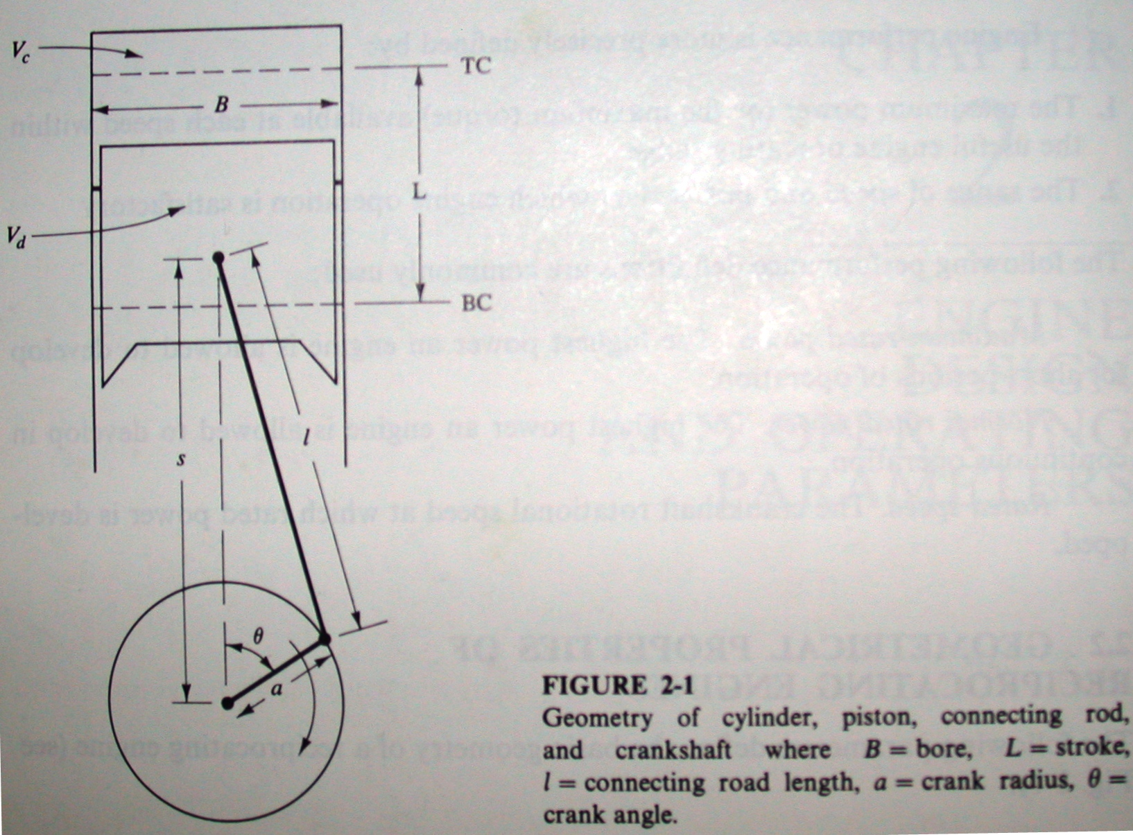
CRANK MECHANISM

Slide 3
EQUATIONS
The cylinder volume V_{θ} at any crank angle:
V_{θ} = Vc + (πB²/4) (l + a – s)
The dimensionless cylinder volume V_{θ}/V₀ as a function of the crank angle:
V_{θ}/V₀ = 1 + ½ (r_{c} – 1) [R + 1 - cosθ - √(R² – sin²θ)]
The piston velocity at any crank angle:
U_{p(θ)} = 2πNa sinθ [1 + cosθ/√(R² – sin²θ)], Or
U_{p(θ)} ≈ 2πNa [sinθ + sin2θ/2R]
The dimensionless piston velocity U_{p(θ)}/Ū_{p} as a function of the crank angle:
U_{p(θ)}/Ū_{p} = (π/2) sinθ [1 + cosθ /√(R² – sin²θ)]
Where R = l/a, Ū_{p} = 2NL

Slide 4


AIR/FUEL AND FUEL/AIR RATIOS
Air/fuel ratio (A/F) =
Fuel/air ratio (F/A) =
Engine | A/F ratio | F/A ratio
SI | 12 ≤ A/F ≤ 18 | 0.056 ≤ F/A ≤ 0.083
CI | 18 ≤ A/F ≤ 70 | 0.014 ≤ F/A ≤ 0.056
Notes:
The stoichiometric (correct) AF for many gasoline-type hydrocarbon fuels is very close to 15:1, with combustion possible for values in the range 6 to 19. AF less than 6 is too rich to sustain combustion and AF greater than 19 is too lean. The fuel input system of an engine, fuel injectors or carburetor, must be able to regulate the proper amount of fuel for any given air flow. Gasoline-fueled engines usually have AF input in the range of 12 to 18 depending on the operating conditions at the time (e.g., accelerating, cruising, starting, etc.).
CI engines typically have AF input in the range of 18 to 70, which appears to be outside the limits where combustion is possible. Combustion occurs because the mixture, with reaction only occurring in those regions where a combustible mixture exists, other regions being too rich or too lean. [Pulkrabek, 2002].

Slide 5
FUEL/AIR EQUIVALENCE RATIOS
Φ – fuel/air equivalence ratio
Φ = (F/A)_{actual} / (F/A)_{stoich}
λ – relative air/fuel ratio
λ = Φ⁻¹ = (A/F)_{actual} / (A/F)_{stoich}
Φ = λ = 1; Stoichiometric (correct) mixture
Φ > 1, λ < 1; rich mixture
Φ < 1, λ > 1; lean mixture

Slide 6
FACTORS IMPORTANT TO ENGINE
The engine’s performance over its operating range
The engine’s fuel consumption within this operating range and the cost of the required fuel
The engine’s noise and air pollutant emissions within this operating range
The initial cost of the engine and its installation
The reliability and durability of the engine, its maintenance requirements, and how these affect engine availability and operating costs
Source: Heywood, Internal combustion engine fundamentals

Slide 7
ENGINE PERFORMANCE
The maximum power (or the maximum torque) available at each speed within the useful engine operating range.
The range of speed and power over which engine operation is satisfactory.
  Maximum rated power. The highest power an engine is allowed to develop for short periods of operation.
  Normal rated power. The highest power an engine is allowed to develop in continuous operation.
  Rated speed. The crankshaft rotational speed at which rated power is developed.

Slide 8
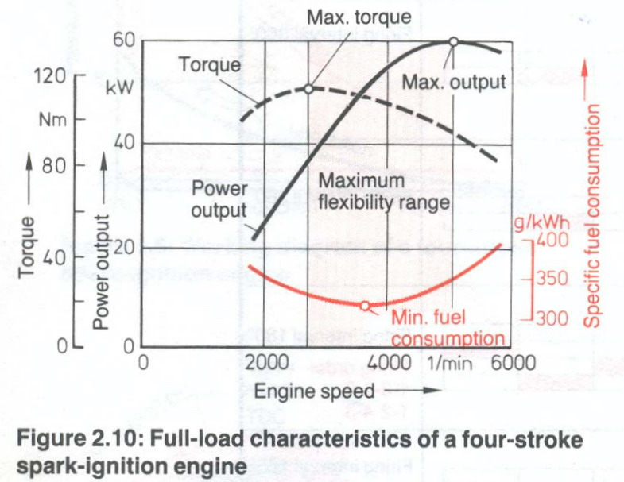
Notes:
During intermediate speeds, volumetric efficiency is high. There is sufficient time for the cylinders to become fairly well “filled up.” This means that with a fairly full charge of air-fuel mixture, higher combustion pressures will develop. With higher combustion pressures, the engine torque is higher.
But, at higher speed, volumetric efficiency drops off. There is not enough time for the cylinders to become filled up with air-fuel mixture. Since there is less air-fuel mixture to burn, the combustion pressures are not as high. There is less push on the pistons. Therefore, engine torque is lower.
The drop of brake power at high speed is due to reduced torque and increased friction power.

Slide 9
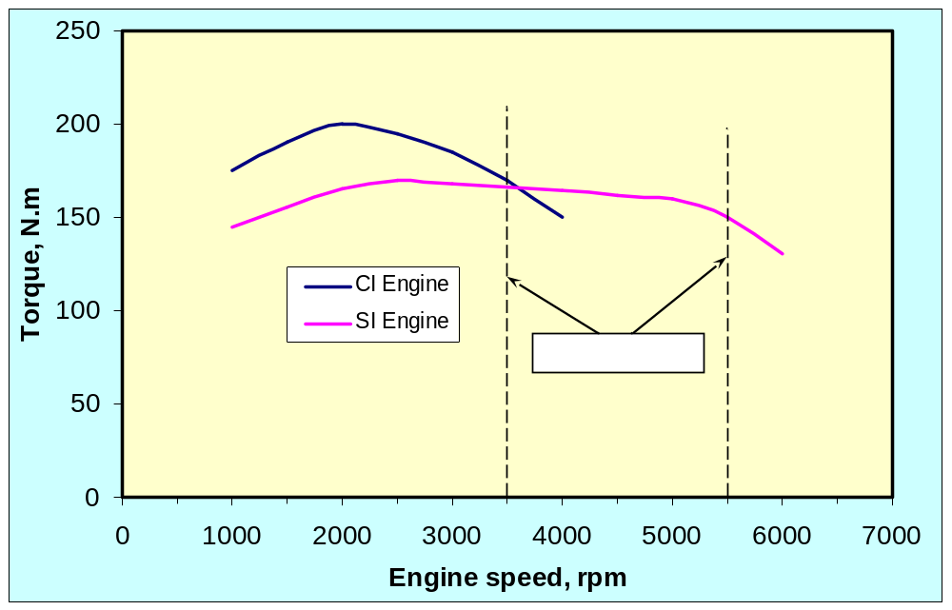
TORQUE VS ENGINE SPEED
Comparative engine maps for SI engine and turbocharged CI engine of similar displacement
Notes:
The maximum power is observed at rated speed and this power is called rated power.

Slide 10
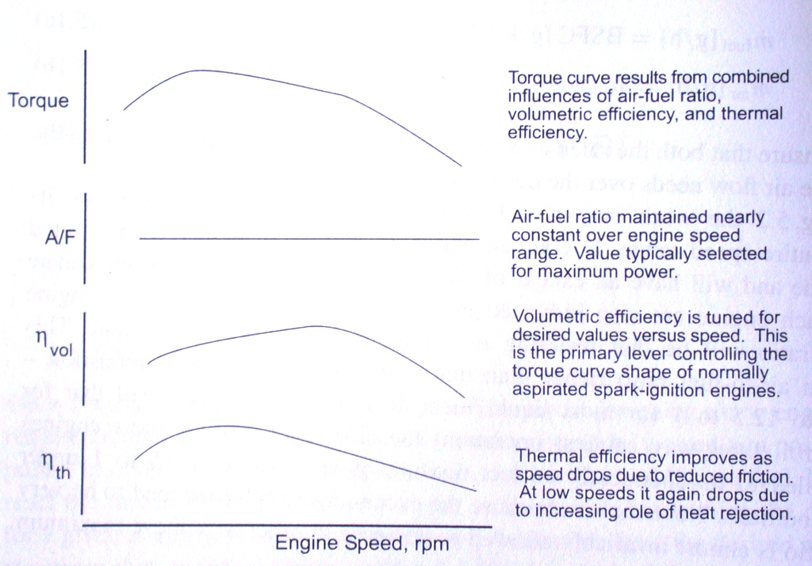
SI ENGINE

Slide 11
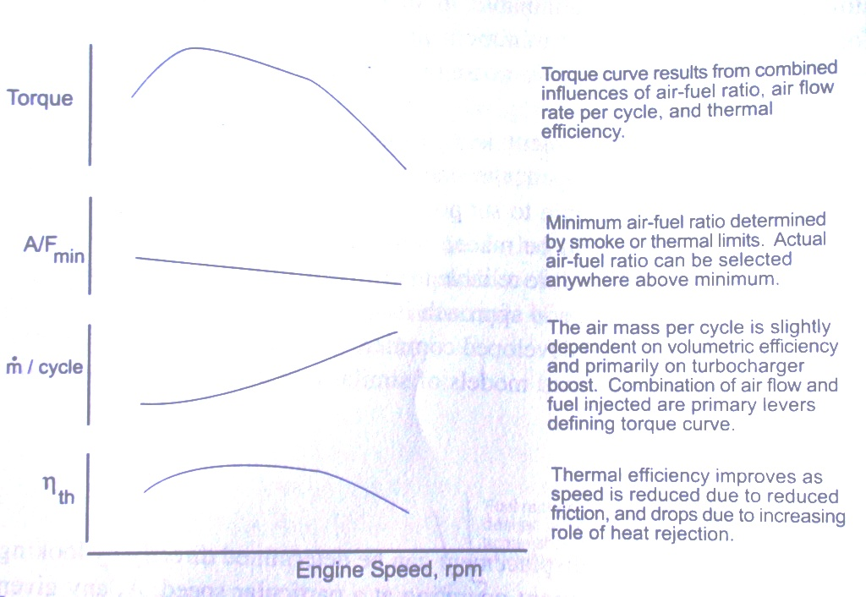
DIESEL ENGINE

Slide 12
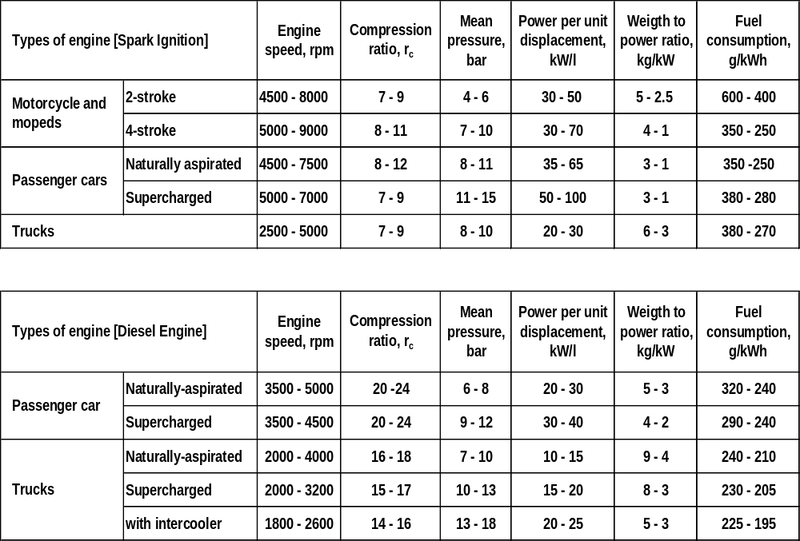
COMPARATIVE DATA
Notes:
Modern automobile engines usually have brake power output per displacement in the range of 40 to 80 kW/l. The Honda eight-valve-per-cylinder V4 motorcycle engine operates about 130 kW/l, an extreme example of high-performance racing engine [Pulkrabek, 2002].

Slide 13
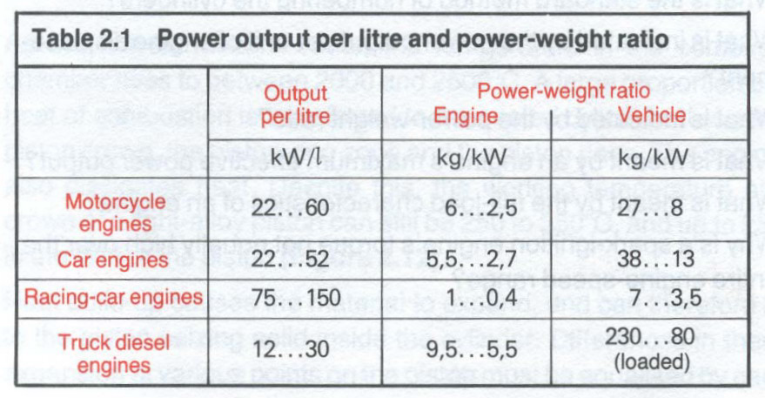
The greater the engine power output in relation to its size and lower its installed weight in relation to the power it produces, the more suitable a high speed engine will be for use in a motor vehicles.

Slide 14
Output per unit of displacement in kW/l
Maximum effective power output
Engine displacement (cubic capacity)
=
Power output per unit of displacement can be increased by forced aspiration (i.e. use of supercharger
Weight (of engine/vehicles)
Maximum effective power output
Power - weight ratio in kg/kW
=

Slide 15
Specific fuel consumption is lowest at a mixture ratio of 1 kg of petrol to 15 kg of air. If the mixture is richer or leaner than this fuel consumption will be higher.
Desirable engine speed for minimum fuel consumption is area between max. torque and max. power output (see Fig. 2.10)
Fuel consumption in litres/100 km
1.1 x Measured fuel consumption [litres] x 100
Length of test route [km]
=
Note: 10% allowance for unfavorable conditions

Slide 17
COMPARISON OF PROPERTIES
Properties of air-fuel mixture
Cp = 1.108 kJ/kg-K
Cv = 0.821 kJ/kg-K
γ = κ = cp/cv = 1.35
R = cp – cv = 0.287 kJ/kg-K
Properties of air
Cp = 1.005 kJ/kg-K
Cv = 0.718 kJ/kg-K
γ = κ = cp/cv = 1.4
R = cp – cv = 0.287 kJ/kg-K

Slide 18
THEORETICAL CALCULATING FORMULA:
Mep [kPa] * Vd [dm³]
6.28* n_{R} [2]
159.2*P [kW]
N [rev/s]
T [Nm]
=
=
Mep [kPa] * Vd [dm³] * N[rpm]
10³ * n_{R} [2] *60
P [kW]
=
Pressure [kPa] * Vtotal [dm³]
R [kJ/kg-K] * T [K]
M_mix [g]
=
Notes:
Greater power can be generated by increasing displacement, mep, and/or speed. Increased displacement increases engine mass and takes up space, both of which are contrary to automobile design trends. For this reason, most of engines are smaller but run at higher speeds, and are often turbocharged or supercharged to increase mep.

Slide 19
THEORETICAL CALCULATING FORMULA:
Mass of mixture (m_mix)
(A/F + 1)
m_{f} [g]
=
Mass if mixture (m_mix) * N[rpm]
(A/F+1) * n_{R} [2] *60
mf [g/s]
=
3600 * m[g] * 4[no of cyl] * N[rpm]
(A/F+1) * n_{R} [2] * 60 * P[kW]
sfc [g/kWh]
=

Slide 20
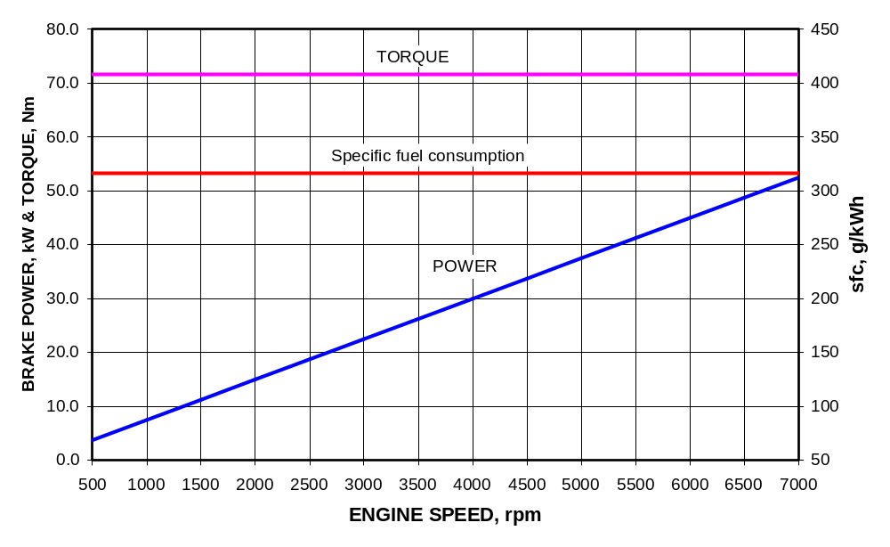
THEORETICAL CHARACTERISTIC CURVES FOR ENGINE
Notes:
In theory, both fuel consumption and torque should remain constant over the entire engine speed range, since same quantity of energy in each cylinder charge should deliver the same amount of rotary force at the crankshaft.
Power output should increase steadily with engine speed. This is the case for indicated power.

Slide 21
EMPIRICAL FORMULA TO CALCULATE POWER
P = P_{max} [ a (N/N_{pmax}) + b (N/N_{pmax})² – c (N/N_{pmax})³]
Where;
a=b=c=1 for 4-stroke petrol engine;
a=0.53, b=1.56, c=1.09 for 4-stoke diesel engine
For 4-storke SI engine:
P = P_{max} * N/N_{pmax} * [ 1 + (N/N_{pmax}) - (N/N_{pmax})²]

Slide 22
P [kW] * 60*1000
2πN [rpm]
T [Nm]
=
Pressure [kPa] * V_{tot} [m³]
R [kJ/kg-K] * T[K] *10⁶
m_{a} [kg]
=
m [g] * N [rpm]
2*60
m˙_{a} [g/s]
=

Slide 23
Make following table to calculate the necessary data
N, rpm | P_{max}, kW | N_{pmax}, rpm | N/N_{pmax} | P_{Brake}, kW | T, Nm | M_{mix}, g | M˙_{f}, g/s | sfc, g/kWh | P_{Frict}, kW
500 | 34 | 6000 | 0.08
1000 | 34 | 6000
7000 | 34 | 6000

Slide 24
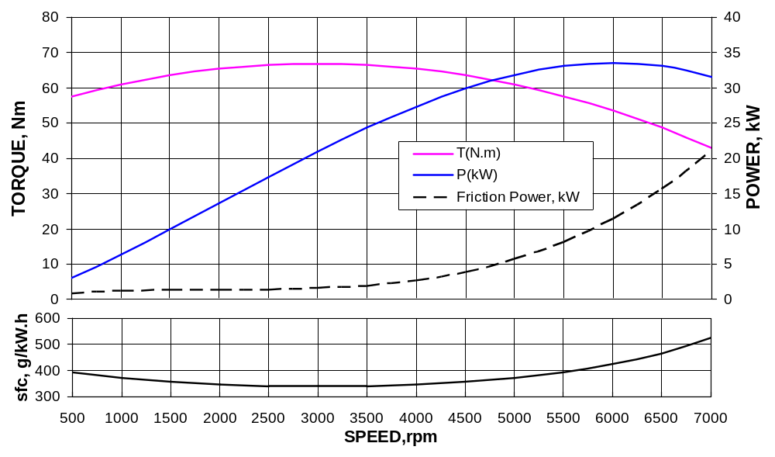
PERFORMANCE CHARACTERISTIC OF SI ENGINE
Notes:
Both torque and power are functions of engine speed. At low speed, torque increases as engine speed increases. As engine speed increases further, torque reaches a maximum and then decreases as shown in fig. Torque decreases because the engine is unable to ingest a full charge of air at higher speeds.
Indicated power increases with speed while brake power increases to a maximum and then decreases. This is because friction power increases with engine speed to a higher power and becomes dominant at higher speeds.
For many automobile engines, maximum brake power occurs at about 6000 to 7000 rpm, about one and a half times the speed of maximum torque.
Greater power can be generated by increasing displacement, mep, and/or speed. Increased displacement increases engine mass and takes up space, both of which are contrary to automobile design trends. For this reason, most of engines are smaller but run at higher speeds, and are often turbocharged or supercharged to increase mep. [Pulkrabek, 2002].
Friction power = IP – BP. It is the power required to overcome the friction of the moving parts in the engine. It increases with the increase of engine speed. With the short stroke (over-square engine) the piston ring friction is lower.

Slide 25
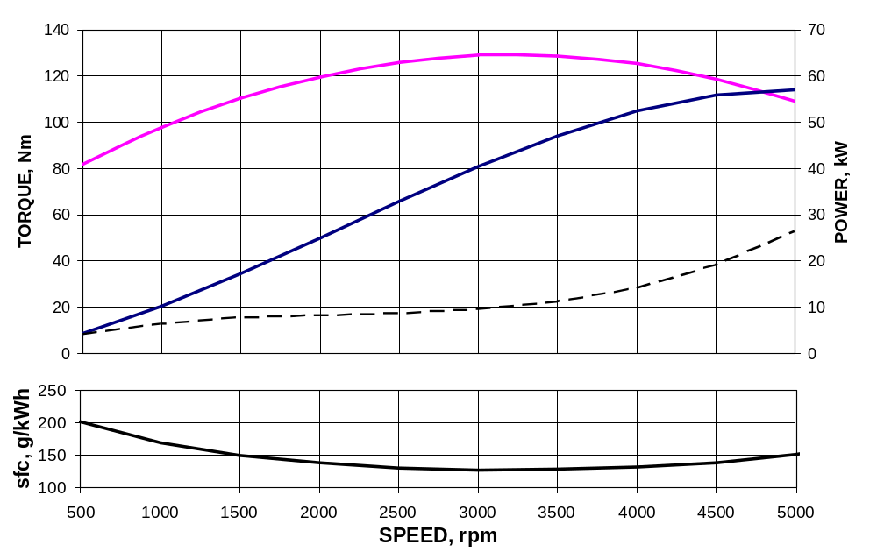
PERFORMANCE CHARACTERISTIC OF CI ENGINE
Notes:
Both torque and power are functions of engine speed. At low speed, torque increases as engine speed increases. As engine speed increases further, torque reaches a maximum and then decreases as shown in fig. Torque decreases because the engine is unable to ingest a full charge of air at higher speeds.
Indicated power increases with speed while brake power increases to a maximum and then decreases. This is because friction power increases with engine speed to a higher power and becomes dominant at higher speeds.
For many automobile engines, maximum brake power occurs at about 6000 to 7000 rpm, about one and a half times the speed of maximum torque.
Greater power can be generated by increasing displacement, mep, and/or speed. Increased displacement increases engine mass and takes up space, both of which are contrary to automobile design trends. For this reason, most of engines are smaller but run at higher speeds, and are often turbocharged or supercharged to increase mep. [Pulkrabek, 2002].
Friction Power = Indicated Power – Brake Power.

Slide 26
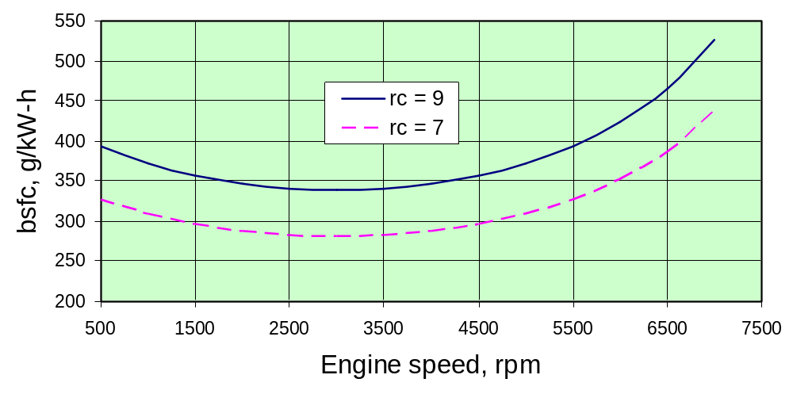
bsfc vs compression ratio
Notes:
Fuel consumption decreases as engine speed increases due to the shorter time for heat loss during each cycle. At higher engine speeds fuel consumption again increases because of high friction losses. As compression ratio is increased fuel consumption decreases due to greater thermal efficiency.

Slide 27
CONCLUSIONS
Both torque and power are functions of engine speed. At low speed, torque increases as engine speed increases. As engine speed increases further, torque reaches a maximum and then decreases. Torque decreases because the engine is unable to ingest a full charge of air at higher speeds.
Indicated power increases with speed while brake power increases to a maximum and then decreases. This is because friction power increases with engine speed to a higher power and becomes dominant at higher speeds.

Slide 28
CONCLUSIONS
For many automobile engines, maximum brake power occurs at about 6000 to 7000 rpm, about one and a half times the speed of maximum torque.
Greater power can be generated by increasing displacement, mep, and/or speed. Increased displacement increases engine mass and takes up space, both of which are contrary to automobile design trends. For this reason, most of engines are smaller but run at higher speeds, and are often turbocharged or supercharged to increase mep. [Pulkrabek, 2002].

Slide 29
HOMEWORK
Derive a formula for the dimensionless cylinder volume V_{θ}/V₀ as a function of the crank angle,θ, compression ratio, r_{c}, and dimensionless stroke,ε = L/2l.
Plot the dimensionless cylinder volume for the case of r_{c} = 10, L = 100 mm, and l = 150 mm.
Derive an equation for dimensionless piston velocity U_{p(θ)}/Ū_{p} as a function of the crank angle.
Plot the dimensionless piston velocity for stroke, L = 100 mm and connecting rod length, l = 150 mm.

